Slide 1
Freight Management : Predicting the cost of shipment
Mentor: Jagannadha Rao
- Prasanna Kumar (Batch 17)

Slide 2
Purpose
The main focus of this study is building a reliable tool to create better visibility of the significance of certain variables on freight cost
It will also work as a tool to support prediction on future transportation values enabling a wide range of cost saving opportunities.

Slide 3
Quick Freight:
The middle man between the customer and freight services will charge from the customer and pay to the freight services and during the transaction they will make their profit/revenue. The challenge is, given a request from a customer for shipment they would like to decide the estimated cost for the Carriers. This information will enable them to quote the best price for the customer and reduce the revenue leakages and increase their bottom line.

Slide 4
Steps Followed
Understand the data
Processing of Data – Cleaning , New feature identification
Visualization
Apply Different Models
Compare the result of Models

Slide 5
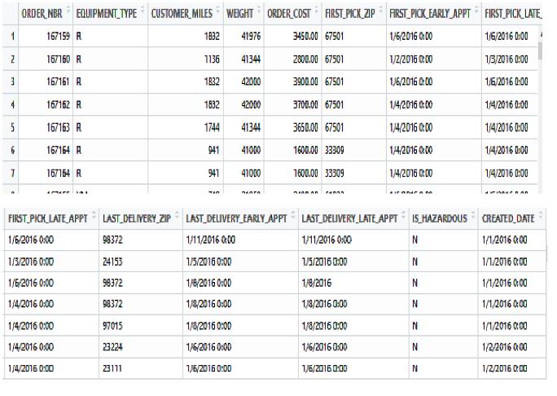
Raw data

Slide 6
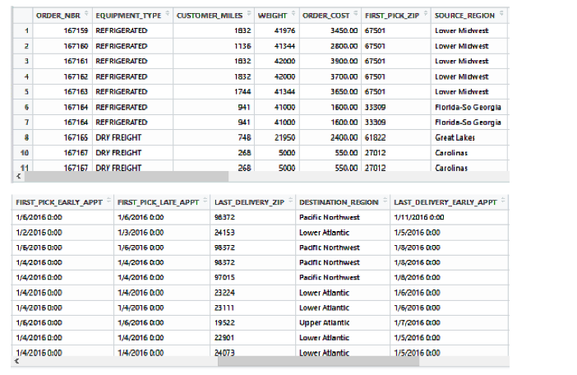
Cleaning the data and adding significant features

Slide 7
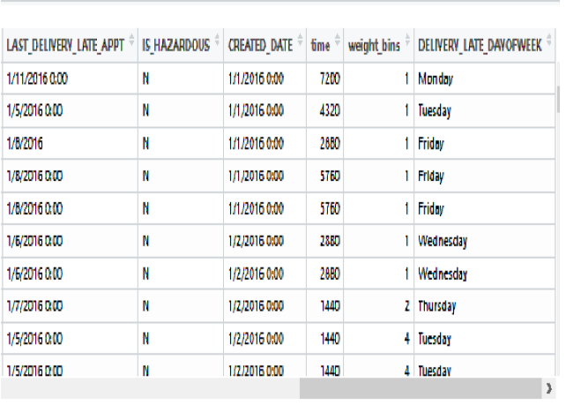
Cleaning the data and adding significant features

Slide 8
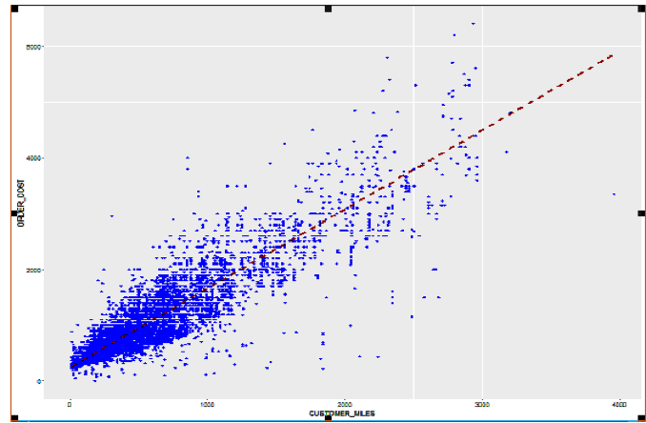
Data Visualization

Slide 9
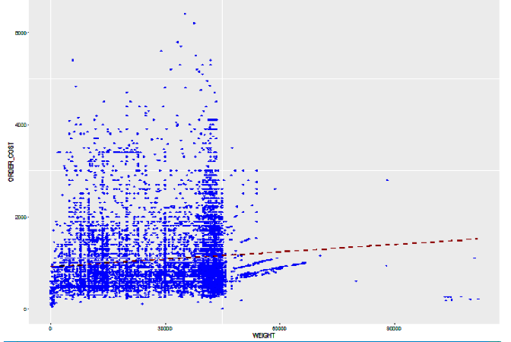

Slide 10
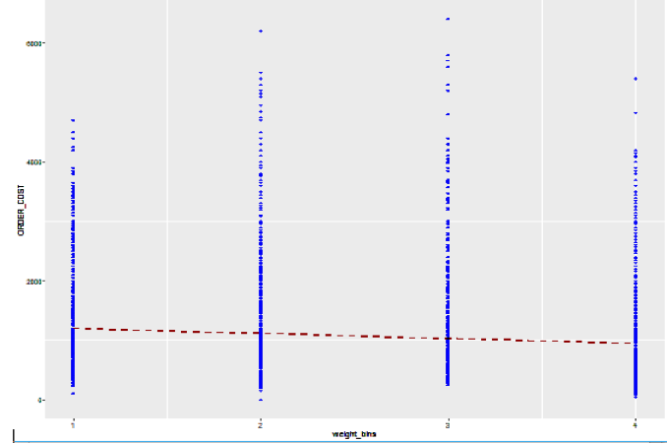

Slide 11
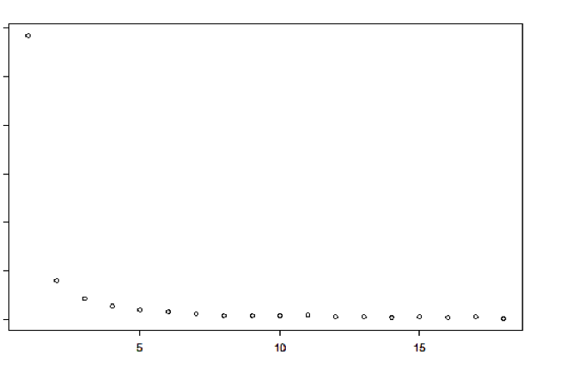

Slide 12
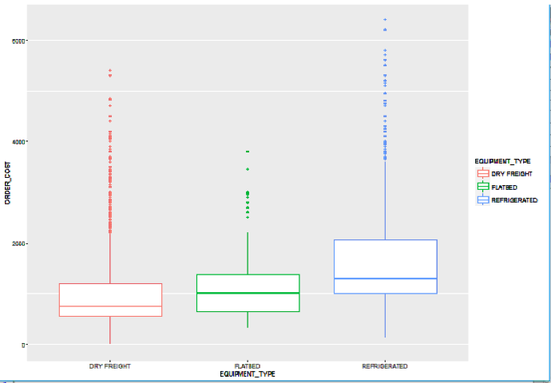

Slide 13
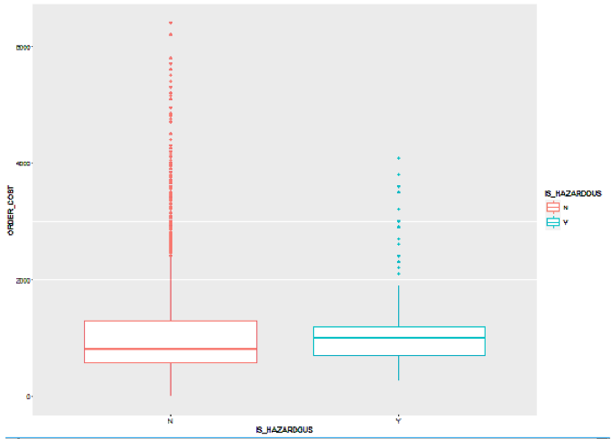

Slide 14
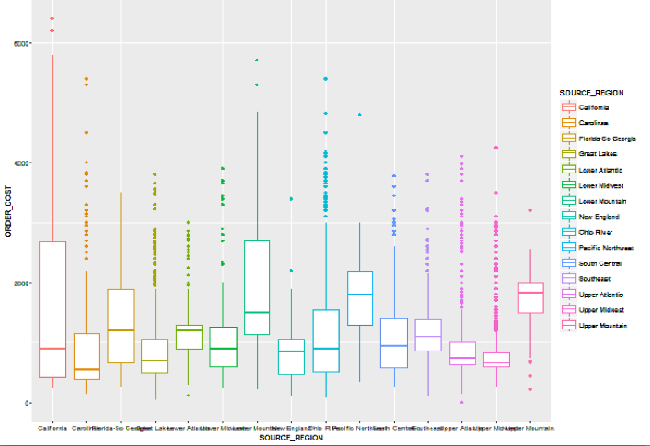

Slide 15
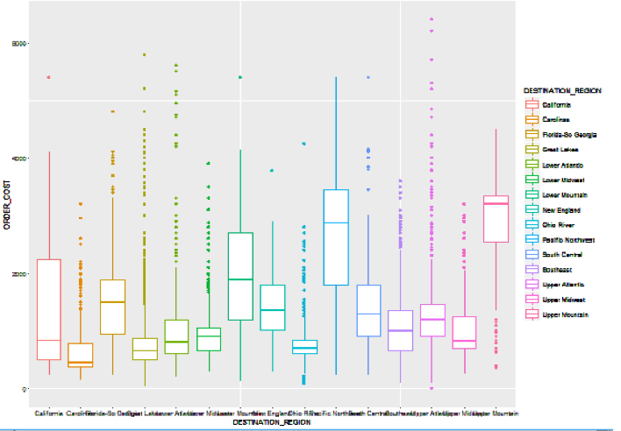

Slide 16
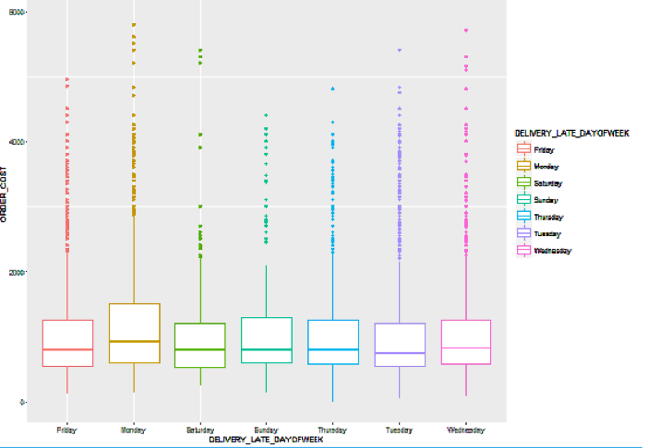

Slide 17
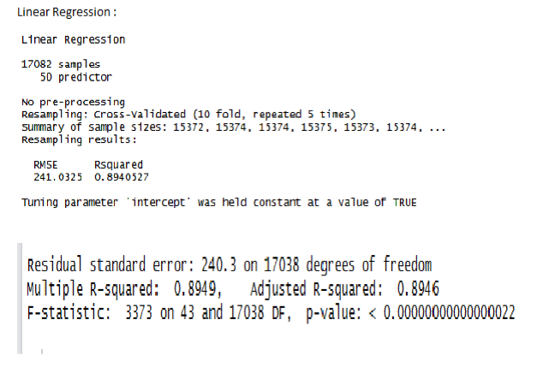
Apply different models

Slide 18
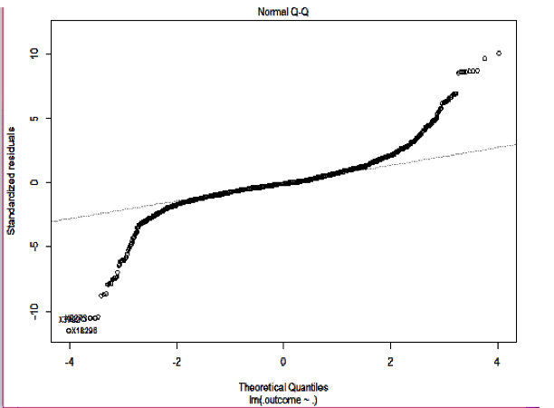

Slide 19
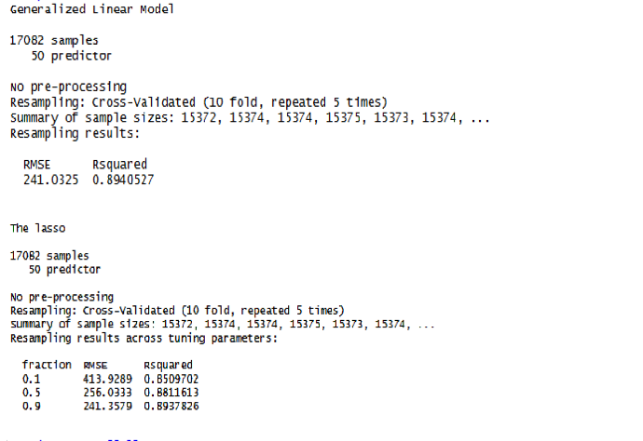

Slide 20
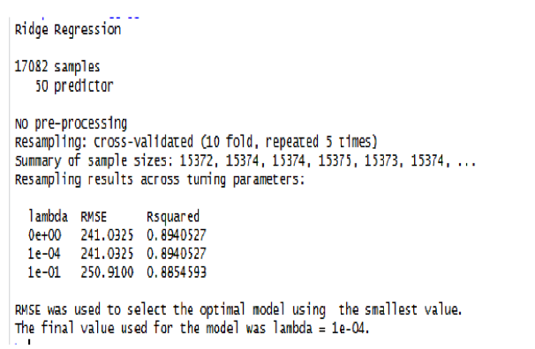

Slide 21
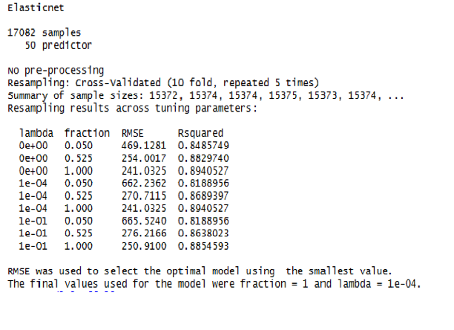

Slide 22
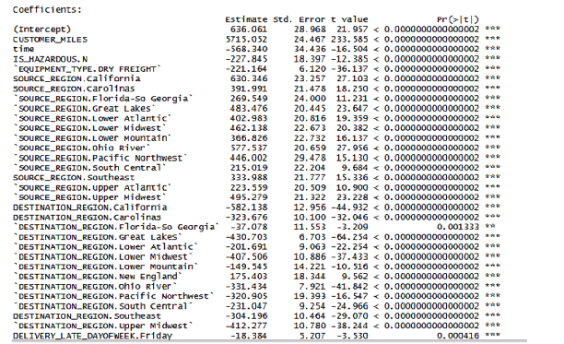
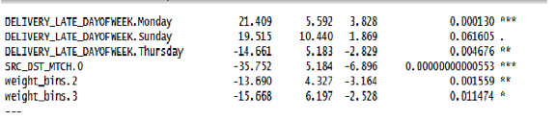

Slide 23
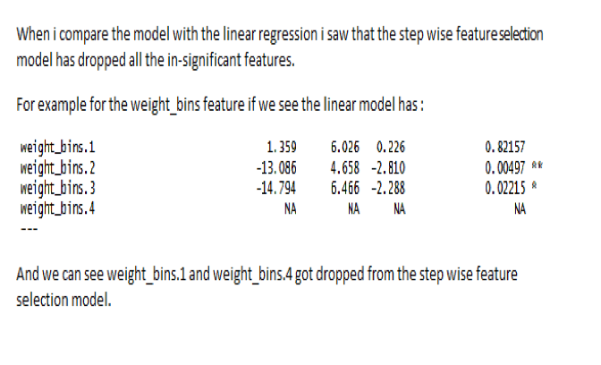

Slide 24
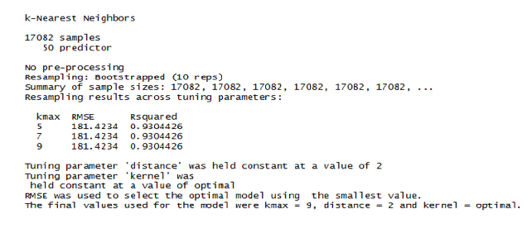

Slide 25
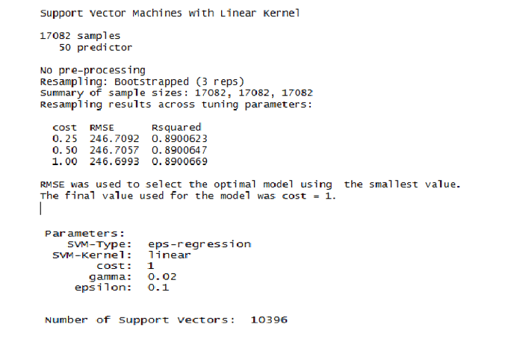

Slide 26
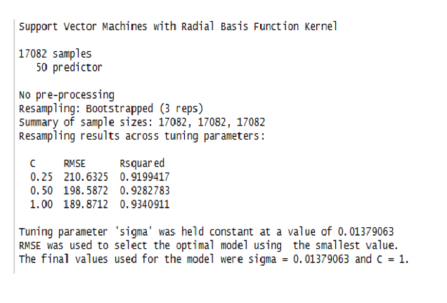

Slide 27
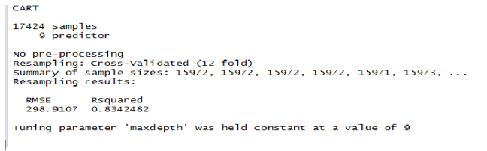
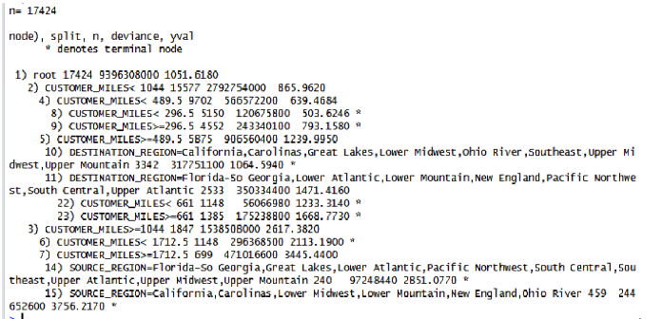

Slide 28
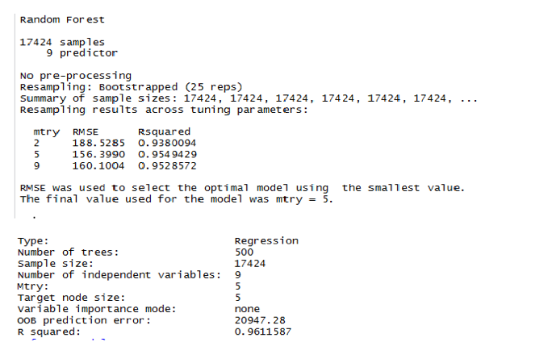

Slide 29
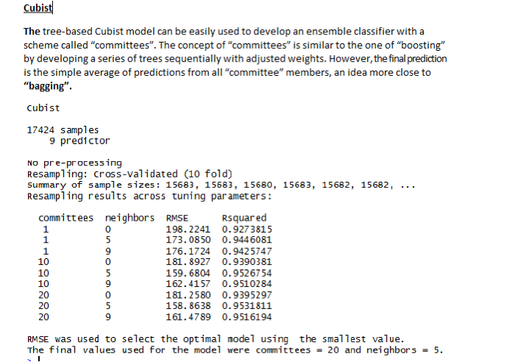

Slide 30
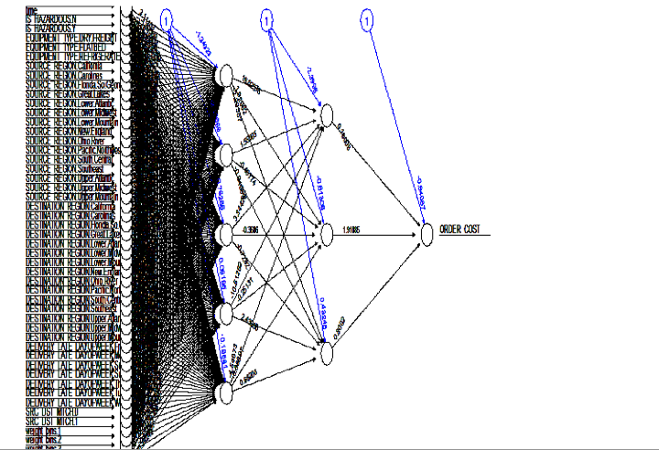

Slide 31
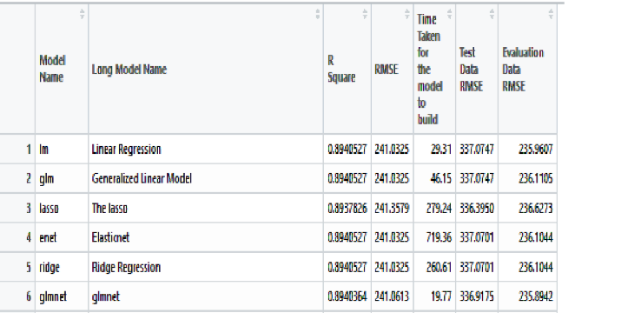
Comparing the results of various models

Slide 32
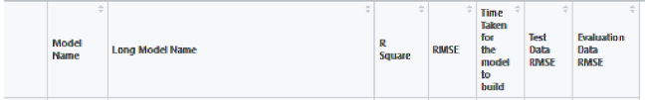
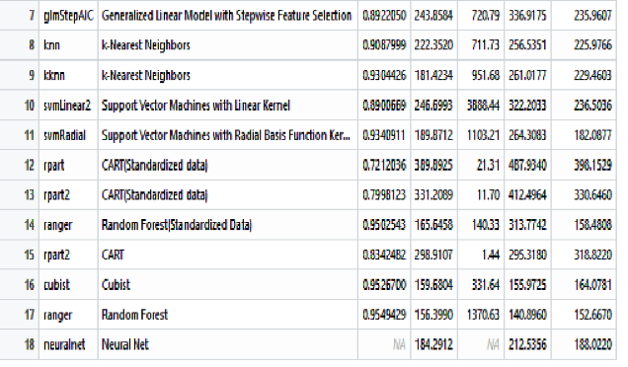

Slide 33
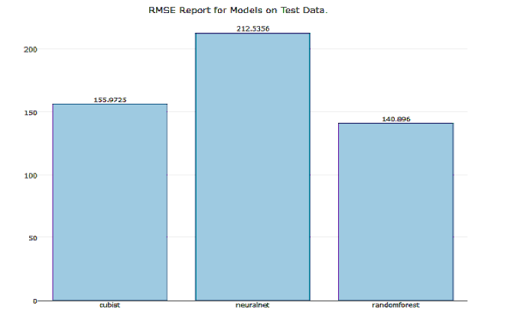
Top 3 models based on Test data Comparison

Slide 34
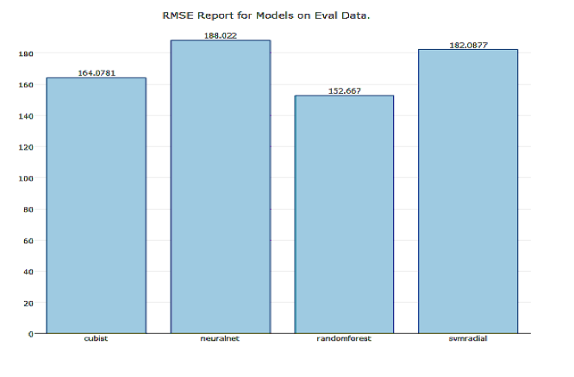
Top 4 models based on Evaluation data Comparison

Slide 35
Conclusion
From the results, it is clear that Neural net , Cubist , Random Forest and even K-Nearest Neighbors, SVM with a radial basis Kernel gave us a good result, but random forest and cubist are the optimum ones.
There is also scope to stack different models and see how the combination of models perform.

